Slide 1
How to Listen Well
SESSION 1 – BEING PRESENT

Slide 2
What is your greatest Need?
TO BE KNOWN AND TO BE LOVED

Slide 3
What is your greatest fear?
TO NOT BE LOVED
TO NOT BE KNOWN
TO BE KNOWN AND NOT LOVED

Slide 4
Where do we start?
Before we can answer the question of “what does it mean to be a good listener?” we need to look at WHY it is so important

Slide 5
A Theology of LISTENING

Slide 6
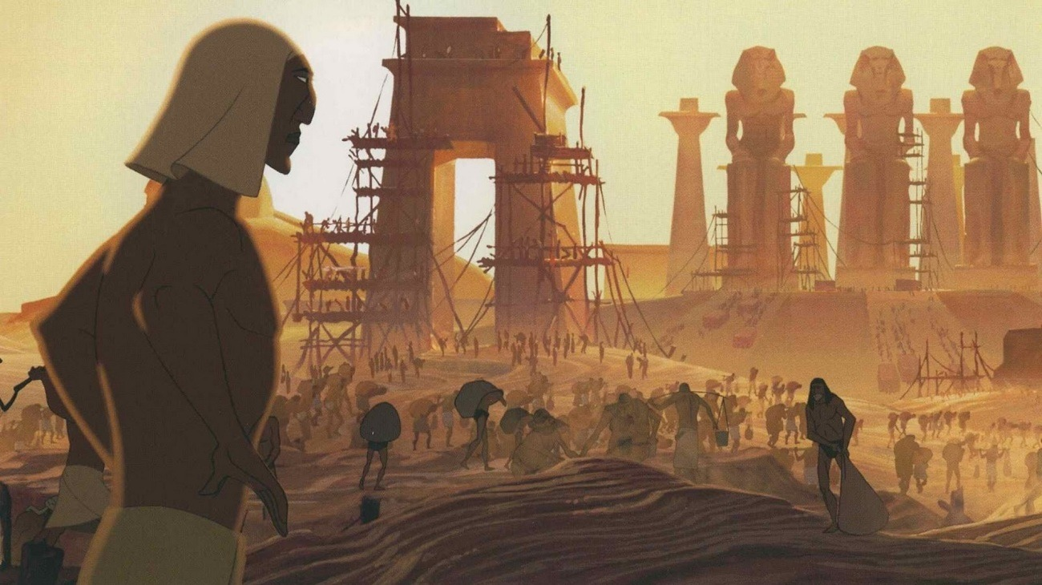
We serve a god who knows us
Exodus 2:23-24
During those many days the king of Egypt died, and the people of Israel groaned because of their slavery and cried out for help. Their cry for rescue from slavery came up to God. And God heard their groaning, and God remembered his covenant with Abraham, with Isaac, and with Jacob. God saw the people of Israel—and God knew.

Slide 7
We Serve a God who loves us
John 3:16-17
For God so loved the world, that he gave his only Son, that whoever believes in him should not perish but have eternal life. For God did not send his Son into the world to condemn the world, but in order that the world might be saved through him.
Romans 5:6-8
For while we were still weak, at the right time Christ died for the ungodly. For one will scarcely die for a righteous person—though perhaps for a good person one would dare even to die— but God shows his love for us in that while we were still sinners, Christ died for us.

Slide 8
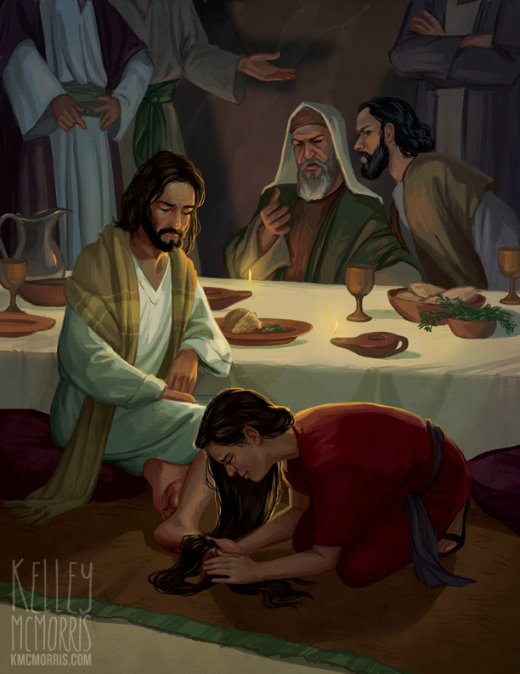
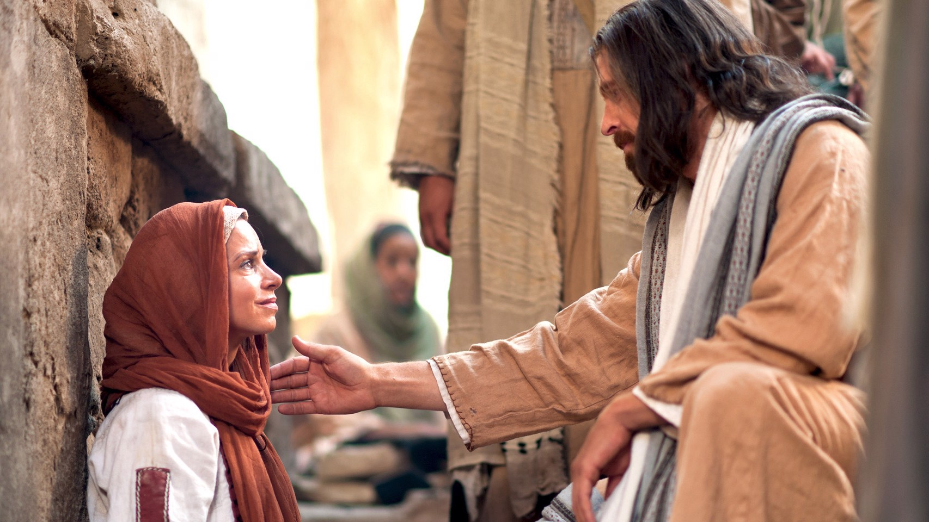
We serve a God who moves toward us
Luke 8:40-48
Luke 7:36-50

Slide 9
Question:
What do we notice about the way Jesus interacts with these two women – how does he demonstrate that he knows them, loves them and moves toward them?

Slide 10
Luke 7:36-50
Then turning toward the woman he said to Simon, “Do you see this woman? I entered your house; you gave me no water for my feet, but she has wet my feet with her tears and wiped them with her hair. You gave me no kiss, but from the time I came in she has not ceased to kiss my feet. You did not anoint my head with oil, but she has anointed my feet with ointment. Therefore I tell you, her sins, which are many, are forgiven—for she loved much. But he who is forgiven little, loves little.” And he said to her, “Your sins are forgiven.” Then those who were at table with him began to say among themselves, “Who is this, who even forgives sins?” And he said to the woman, “Your faith has saved you; go in peace.”

Slide 11
Luke 8:40-48
And when the woman saw that she was not hidden, she came trembling, and falling down before him declared in the presence of all the people why she had touched him, and how she had been immediately healed. And he said to her, “Daughter, your faith has made you well; go in peace.”

Slide 12
What is our Calling?
TO IMITATE CHRIST

Slide 13
know others love others move toward others
To imitate Christ is to…

Slide 14
Some reminders

Slide 15
We are created for relationship
Genesis 2:18
God says “It is not good for man to be alone”
1 John 4:12
Beloved, if God so loved us, we also ought to love one another. No one has ever seen God; if we love one another, God abides in us and his love is perfected in us.

Slide 16
Relationships are not about “Us”
“Relationships are not primarily for our fulfillment . . . Effective personal ministry begins when we confess that we have taken relationships that belong to God and used them for our own selfish purposes.”
Paul Tripp – Instruments in the
Redeemer’s Hands
Ephesians 5:1-2
Therefore be imitators of God, as beloved children. And walk in love, as Christ loved us and gave himself up for us, a fragrant offering and sacrifice to God.

Slide 17
Question:
Stop and think about those around you:
your spouse, your kids, your parents, your siblings, your friends, your co-workers – what would happen if you started to see them as belonging to God?

Slide 18
Relationships are messy because people are
“. . . relationships between sinners are messy, difficult, labour intensive, and demanding, but in that, they are designed to result in God’s glory and our good as he is worshipped and our hearts are changed.”
– Paul Tripp
“Jesus introduced a new era in which weakness is the new strength. Anything that reminds us that we are dependent on God and other people is a good thing.”
– Ed Welch

Slide 19
Reflect: QUESTION:
Think about the mess of your own life – when was the last time you truly let someone into the mess?
How can sharing our own mess help us to learn to share in the mess of others’ lives?

Slide 20
We are called into the mess
Galatians 6:2
Bear one another’s burdens, and so fulfill the law of Christ.
“God daily gives us opportunities to serve the troubled, angry, discouraged, defeated confused and blind. This is the way he works and he calls each of his children to be part of it.”
– Paul Tripp
JOHN 15:12
This is my commandment, that you love one another as I have loved you.

Slide 21
Question:
What are some of the things that hold you back from stepping into the mess of relationships?

Slide 22
Moving FORWARD

Slide 23
We are UNITED WITH CHRIST
John 15:5
I am the vine; you are the branches. Whoever abides in me and I in him, he it is that bears much fruit, for apart from me you can do nothing.

Slide 24
We are EQUIPPED WITH THE SPIRIT
John 14:25-26
These things I have spoken to you while I am still with you. But the Helper, the Holy Spirit, whom the Father will send in my name, he will teach you all things and bring to your remembrance all that I have said to you.
Romans 8:26
Likewise the Spirit helps us in our weakness. For we do not know what to pray for as we ought, but the Spirit himself intercedes for us with groanings too deep for words.

Slide 25
“With the Spirit, we move toward other people and are amazed that God uses ordinary people to do his kingdom work.”
Ed Welch – Side by Side

Slide 26
Your mission

Slide 27
Who are the people in your life that God is calling you to KNOW? How can you begin to LOVE others in the “way of Christ”? What is it going to take for you to MOVE TOWARD others?
BEING PRESENT:

Slide 28
Next SESSION:
SESSION 2 – Listening Skills

